Slide 1
Retrofitting Tests
Tony Baines

Slide 2
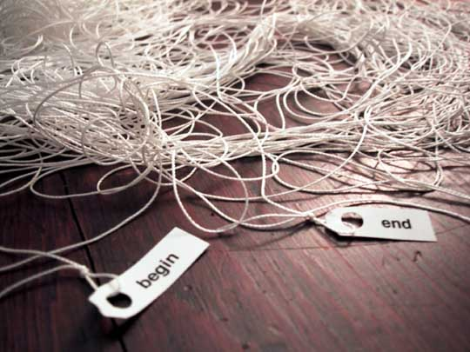
Legacy Code
We don’t always start with a clean sheet of paper.
“Our summer student put this together – can you make these changes …”
Sometimes ‘tactical’ becomes ‘strategic’
“This tool is essential to the platform – fix it!”
We never stop learning.
“It’s about that system you wrote 6 years ago …”

Slide 3
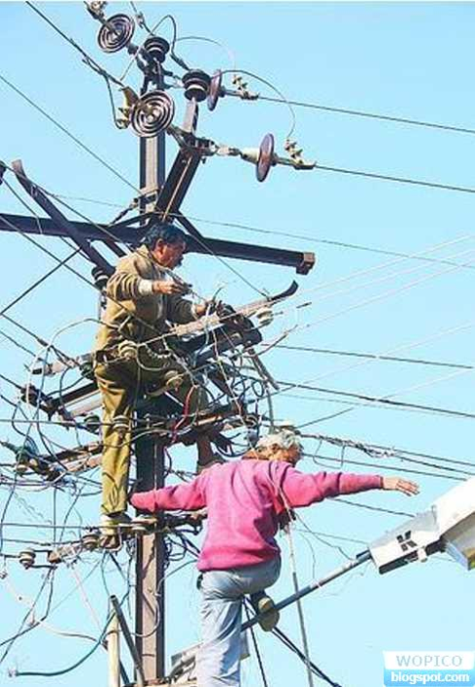
Risky Business
Some jobs are safer than others
How do I make it safer?
Is it worth the cost?

Slide 4

The Cost Of Change
Changing unknown code can be a leap of faith
I want to make it cleaner, but how do I know I won’t break it?
… and I’m certain I’ll be back again next month
For my next trick, I will require the use of a safety net

Slide 5
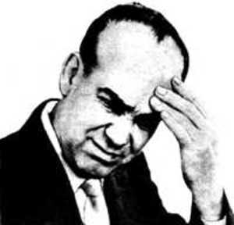
Weaving the net
Find the code you need to change
Get it to compile on it’s own (no collaborators)
May need mocks, stubs or language tricks
Guess a behaviour and capture with an assertion
Characterisation tests
Repeat guess and test for happy and sad paths
Coverage tools can help

Slide 6
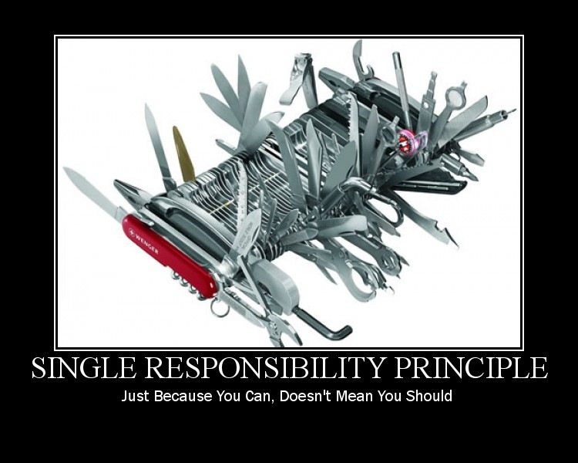
An Example

Slide 7

And the payback is …
With my tests is place I can
Make these changes, and the next ones, and the next ones
Refactor
Add assertions to my build to stop the coverage from falling

Slide 8
